Slide 1
Agenda
  Introduction
  User guidance
  Abnormal cases

Slide 2
introduction
TortoiseSVN:
A free open-source client for the version control system (Subversion – SVN)
Managing files and directories over time.
Files are stored in a central Repository.

Slide 3
introduction
  Icon overlays

Slide 4
introduction
  Icon overlays
  Normal: the Subversion status is normal.
  Readonly: if you have set the needs-lock property on a file, Subversion makes that file read-only until you get a lock on that file
  Added: file or folder has been scheduled to be added to version control
  Modified: files were changed since you last updated your working copy and need to be committed.
  Deleted: files or folders inside the current folder have been scheduled to be deleted from version control or a file under version control is missing in a folder.

Slide 5
introduction
  Icon overlays
  Ignored: a file or folder is ignored for version control purposes. This overlay is optional.
  Conflicted: If during an update a conflict occurs then the icon changes to a yellow exclamation mark.
  Lock: reminds you that you should release the lock if you are not using it to allow others to commit their changes to the file.
  Non-version: files and folders which are not under version control, but have not been ignored. This overlay is optional.

Slide 6
introduction
The Repository is much like an ordinary file server, except that it remembers every change ever made to your files and directories.

Slide 7
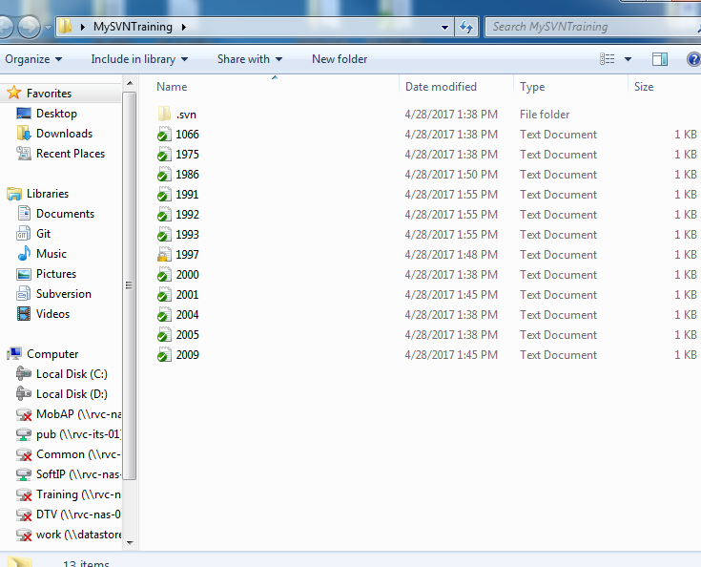
introduction
Working copy is an ordinary directory tree on your local system. It’s your own private work area

Slide 8
introduction
  Context menu

Slide 9
introduction
  Branch
Branch is a copy of code derived from a certain point in the trunk.
Branch is used for making changes to the code without affecting the code in the trunk.

Slide 10
introduction
  Tag
Tag is a point on the trunk or branch that you wish to preserve.
A tag will be created if this is a stable point of the software.

Slide 11
Agenda
  Introduction
  User guideline
  Abnormal cases

Slide 12
USER GUIDANCE
Import into Repo
At the first time, there is no document or source code in repository. In order to manage these source files by SVN, you must import them onto the repository
Pre-condition: non-version
Post-condition:
Notes:
.

Slide 13
USER GUIDANCE
Import into Repo
Right click on the import folder.
Choose TortoiseSVN → Import.
Fill out the address of your source and message.
Notes:
.

Slide 14
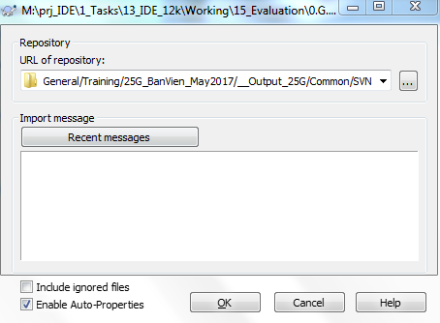
USER GUIDANCE
Import into Repo
Notes:
.

Slide 15
USER GUIDANCE
Checkout SVN
You can not directly edit your source files on the repository. If you want to work with your source files, you must create your working directory and checkout source files from the repository to your working directory.
Pre-condition: non-version
Post-condition:
Notes:
Fully recursive
Checkout the entire tree, including all child folders and sub-folders.
Immediate children, including folders
Checkout the specified directory, including all files and child folders, but do not populate the child folders.
Only file children
Checkout the specified directory, including all files but do not checkout any child folders.
Only this item
Checkout the directory only. Do not populate it with files or child folders
Working copy
Retain the depth specified in the working copy. This option is not used in the checkout dialog, but it is the default in all other dialogs which have a depth setting.
HEAD revision: Export the latest version.
Revision: Chose the version that you want to be exported. Click “Show log” to see more information about versions, then you can chose the right version that you want to.

Slide 16
USER GUIDANCE
Checkout SVN
Right click → SVN Checkout.
Specifies URL of repository, checkout directory.
Optional: Specifies “Checkout Depth”. Default is “Fully recursive”.
Optional: “Revision” and “HEAD revision”. Default is “HEAD revision”.
A message box appears to help you determine that the revision which you are checking out is correct or not.
Notes:
Fully recursive
Checkout the entire tree, including all child folders and sub-folders.
Immediate children, including folders
Checkout the specified directory, including all files and child folders, but do not populate the child folders.
Only file children
Checkout the specified directory, including all files but do not checkout any child folders.
Only this item
Checkout the directory only. Do not populate it with files or child folders
Working copy
Retain the depth specified in the working copy. This option is not used in the checkout dialog, but it is the default in all other dialogs which have a depth setting.
HEAD revision: Export the latest version.
Revision: Chose the version that you want to be exported. Click “Show log” to see more information about versions, then you can chose the right version that you want to.

Slide 17
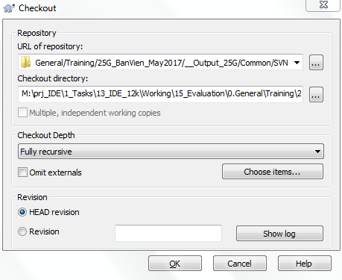
USER GUIDANCE
Checkout SVN
Notes:
Fully recursive
Checkout the entire tree, including all child folders and sub-folders.
Immediate children, including folders
Checkout the specified directory, including all files and child folders, but do not populate the child folders.
Only file children
Checkout the specified directory, including all files but do not checkout any child folders.
Only this item
Checkout the directory only. Do not populate it with files or child folders
Working copy
Retain the depth specified in the working copy. This option is not used in the checkout dialog, but it is the default in all other dialogs which have a depth setting.
HEAD revision: Export the latest version.
Revision: Chose the version that you want to be exported. Click “Show log” to see more information about versions, then you can chose the right version that you want to.

Slide 18
USER GUIDANCE
Show log
Choose “Show log” see logs (history) of file/folder.
Pre-condition: normal/deleted/modified/locked
Post-condition: normal/deleted/modified/locked
Right click on the import folder.
Choose TortoiseSVN → Show log

Slide 19
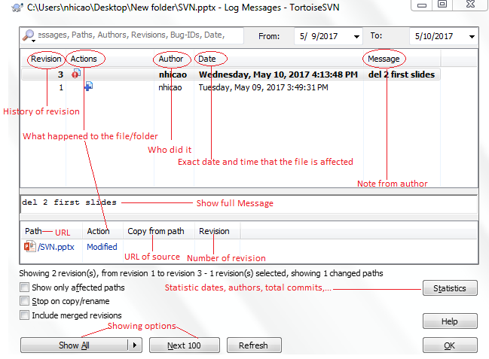
USER GUIDANCE
Show log

Slide 20
USER GUIDANCE
Repo-browser
Sometimes you need to work directly on the respository without having a working copy.
Pre-condition: all states
Post-condition:
Right click on the import folder.
Choose TortoiseSVN → Repo-browser

Slide 21
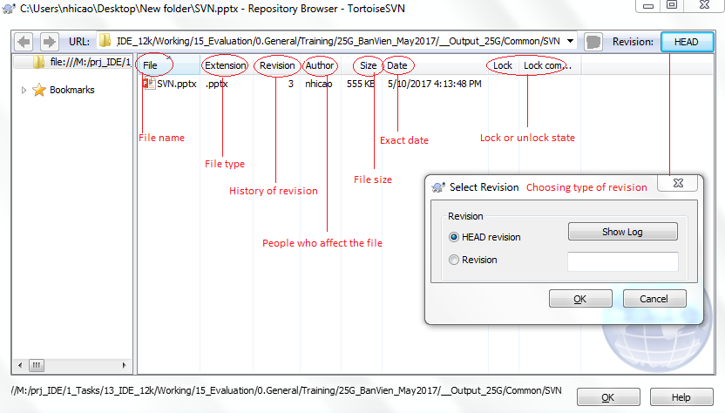
USER GUIDANCE
Repo-browser

Slide 22
USER GUIDANCE
Check for modifications
Displaying a list of all changed files in the working copy
Pre-condition: all states
Post-condition:
Right click on the import folder.
Choose TortoiseSVN → Check for modifications

Slide 23
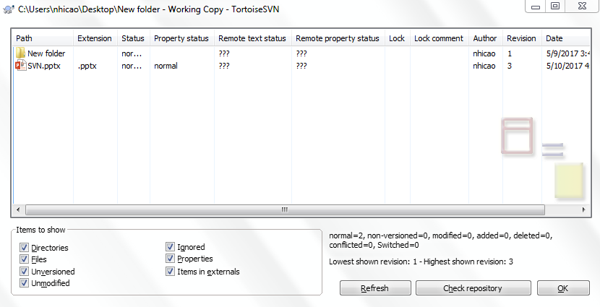
USER GUIDANCE
Check for modifications

Slide 24
USER GUIDANCE
Revision graph
Sometimes you need to know where branches and tags were taken from the trunk, and the ideal way to view this sort of information is as a graph or tree structure.
Pre-condition: all states except add, non-version and ignored
Post-condition:
Right click on the import folder.
Choose TortoiseSVN → Revision graph

Slide 25
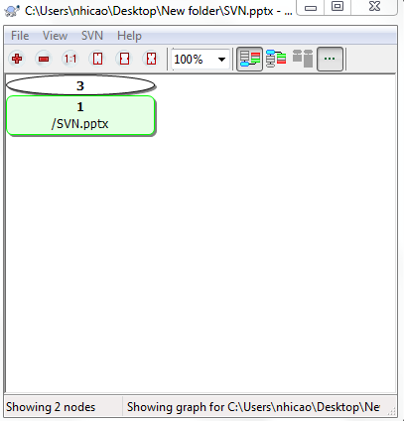
USER GUIDANCE
Revision graph

Slide 26
USER GUIDANCE
Resolved
Removing conflict state on working copy files/folders.
Pre-condition: conflict
Post-condition:
Right click on the import folder.
Choose TortoiseSVN → Resolved

Slide 27
USER GUIDANCE
Resolved

Slide 28
USER GUIDANCE
Update to revision
Running a reverse merge, undoing the changes in working copy. You can choose “HEAD revision” to update to the latest revision or fill in the “Revision” field to choose the revision you want.
Pre-condition: normal/deleted/modified/locked
Post-condition:
Right click on the file/folder.
Choose TortoiseSVN → Update to revision

Slide 29
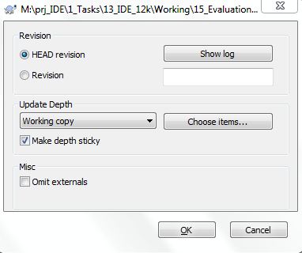
USER GUIDANCE
Update to revision

Slide 30
USER GUIDANCE
Rename
Rename for file/folder.
Pre-condition: added/deleted/modified,/locked
Post-condition:
Right click on the file/folder.
Choose TortoiseSVN → Rename

Slide 31
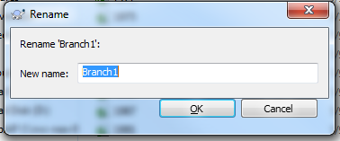
USER GUIDANCE
Rename

Slide 32
USER GUIDANCE
Delete
Remove files/folders from subversion
Pre-condition: locked/deleted/modified
Post-condition:
Right click on the file/folder.
Choose TortoiseSVN → Delete

Slide 33
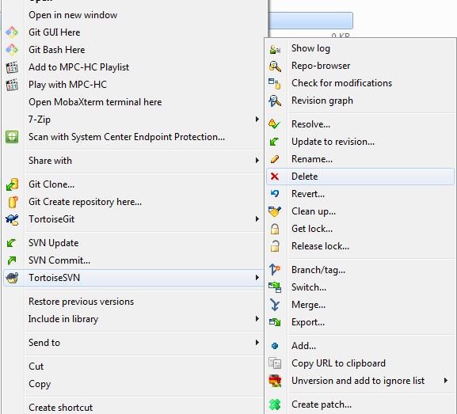
USER GUIDANCE
Delete

Slide 34
USER GUIDANCE
Revert
Revert any local changes to a file/folder
Pre-condition: normal/deleted/modified
Post-condition:
Right click on the file/folder.
Choose TortoiseSVN → Revert

Slide 35
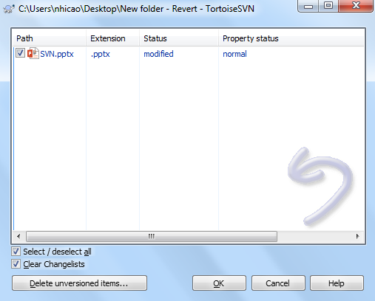
USER GUIDANCE
Revert

Slide 36
USER GUIDANCE
Clean up (folder)
Recursively clean up the working copy, removing working copy locks and resuming unfinished operations
Pre-condition: normal
Post-condition:
Right click on the folder.
Choose TortoiseSVN → Clean up

Slide 37
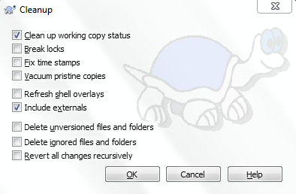
USER GUIDANCE
Clean up

Slide 38
USER GUIDANCE
Get Lock
Lock working copy paths or URL in the repository so that no other can commit changes to them.
Pre-condition: normal/deleted/modified
Post-condition:
Right click on the file/folder.
Choose TortoiseSVN → Get lock

Slide 39
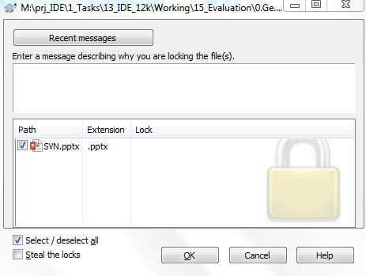
USER GUIDANCE
Get Lock

Slide 40
USER GUIDANCE
Release Lock
To unlock locked file/folder.
Pre-condition: locked
Post-condition:
Right click on the file/folder.
Choose TortoiseSVN → Release lock

Slide 41
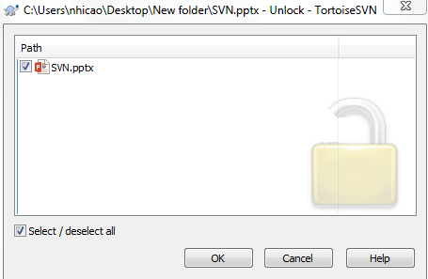
USER GUIDANCE
Release Lock

Slide 42
USER GUIDANCE
Diff operation:
To see what changes you have made in your working copy.
Pre-condition: all states
Post-condition:
Right click on file
Choose TortoiseSVN → Diff with…
Notes:
To compare current file in working copy and previous version, later version,… of that file.

Slide 43
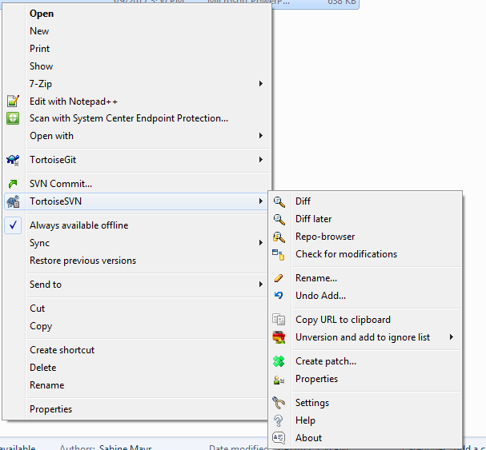
USER GUIDANCE
Diff operation:
Notes:
To compare current file in working copy and previous version, later version,… of that file.

Slide 44
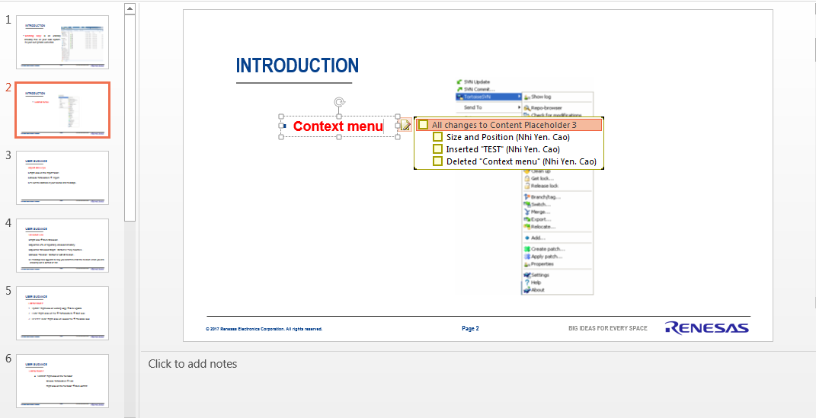
USER GUIDANCE
Diff operation:
Notes:
To compare current file in working copy and previous version, later version,… of that file.

Slide 45
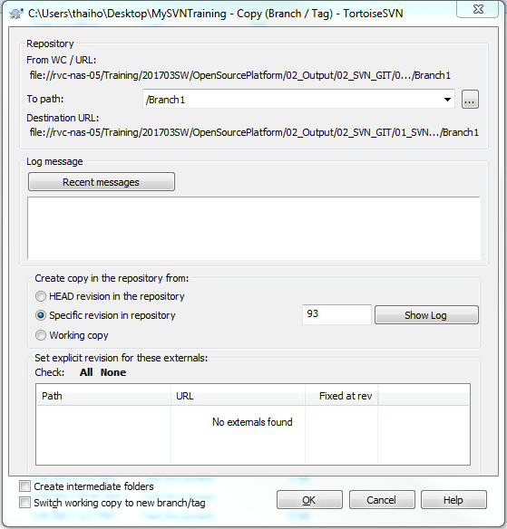
USER GUIDANCE
Branch
Create a new branch from a revision.
Right Click > TortoiseSVN > Branch/Tag…
Fill out the part to create a folder containing new branch.
You can choose to create branch from
  HEAD revision
  Specific revision (Revison number or Choose from log)
  Working copy
Notes:
To release final output

Slide 46
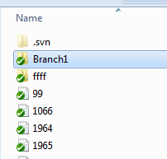
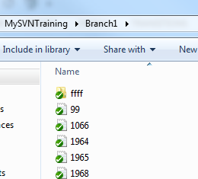
USER GUIDANCE
Branch
The branch will be a copy of the revision which it starts from.
Notes:
To release final output

Slide 47
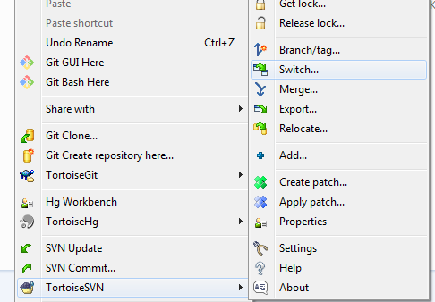
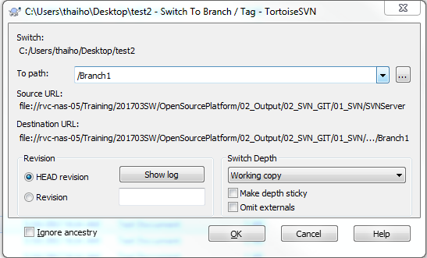
USER GUIDANCE
Switch
Switch from a certain branch to another branch.
Right Click on the current branch > TortoiseSVN > Switch…
Choose the path containing branch.
You can switch to another branch by simply enter the folder of that branch.
Notes:
To release final output

Slide 48
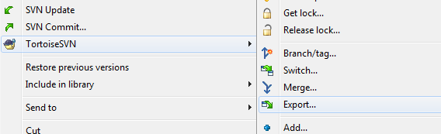
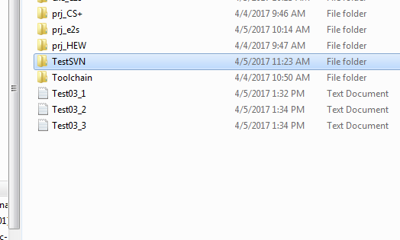
USER GUIDANCE
Export
Export operation is used to release final output to customers.
After exporting, there will be no marks on the released folder because there is no .svn folder, which contains information about repository and revisions.
Notes:
To release final output

Slide 49
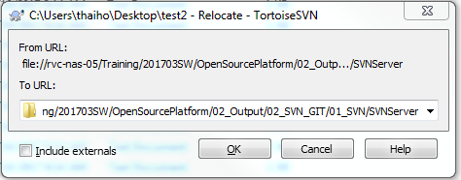
USER GUIDANCE
Relocate
Your working copy is relocated to a new URL that you fill out
Notes:
To compare current file in working copy and previous version, later version,… of that file.

Slide 50
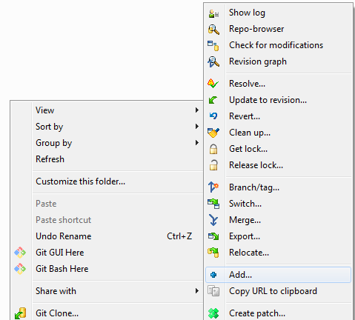
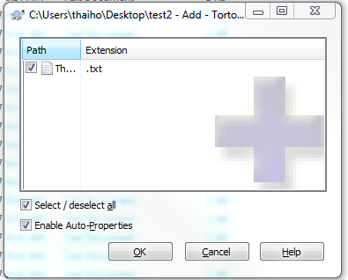
USER GUIDANCE
Add
You can add a new file to your working copy by using:
Notes:
To compare current file in working copy and previous version, later version,… of that file.

Slide 51
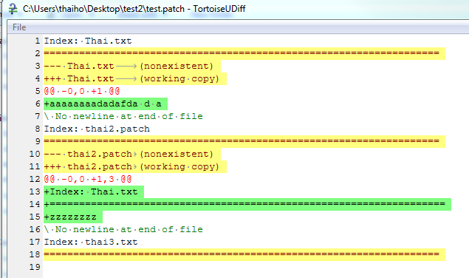
USER GUIDANCE
Create patch
Using create path to store head a version data of file (path file)
Notes:
To release final output

Slide 52
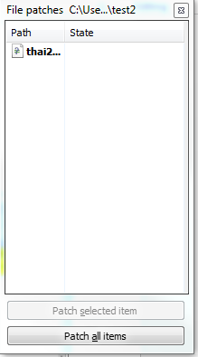
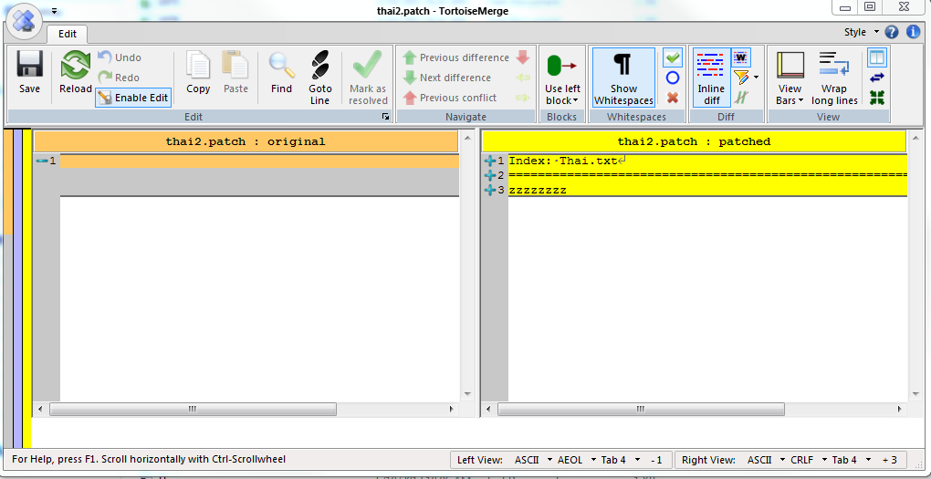
USER GUIDANCE
Apply patch
Using apply path to compare original version with patched version of file. You can also modify this file
Notes:
To release final output

Slide 53
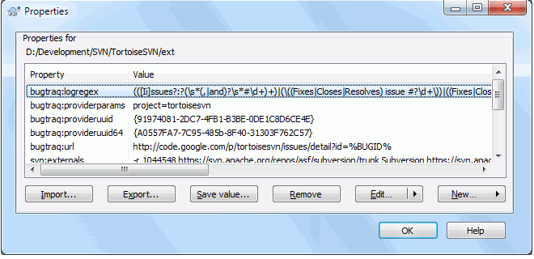
USER GUIDANCE
Properties
You can read and set the Subversion properties from the Windows properties dialog from Context menu → properties.
Notes:
To release final output

Slide 54
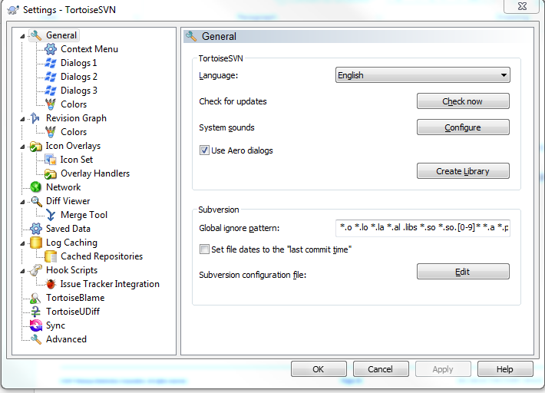
USER GUIDANCE
Settings
To find out what the different settings are for, just leave your mouse pointer a second on the edit-box/check-box... and a helpful tooltip will popup.
This dialog allows you to specify your preferred language, and the Subversion-specific settings.
Notes:
To release final output

Slide 55
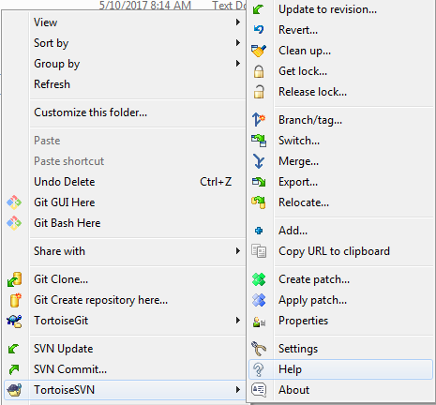
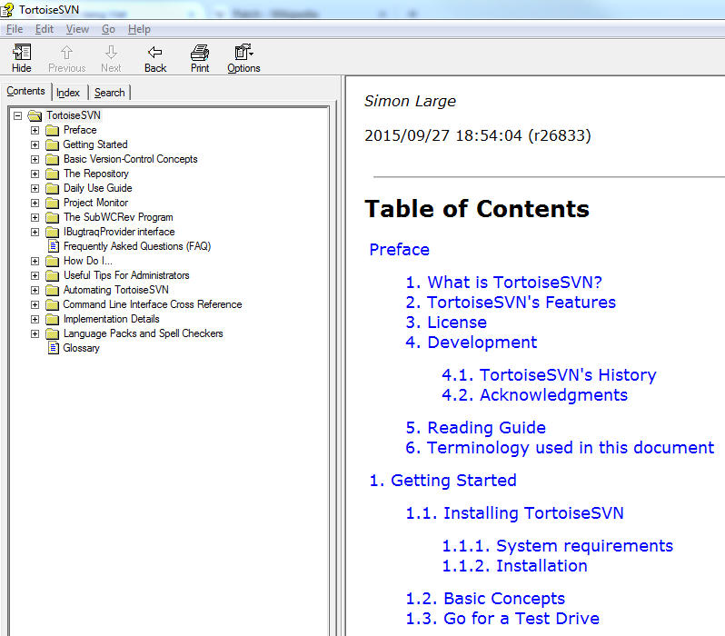
USER GUIDANCE
Help
To see more information about daily use guide , you can see Help dialog
Notes:
To release final output

Slide 56
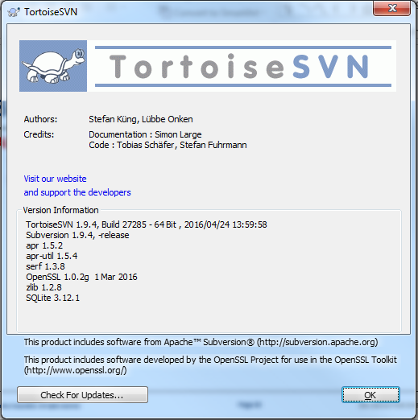
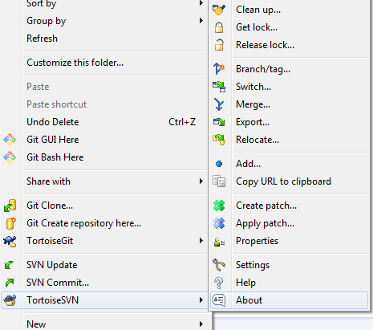
USER GUIDANCE
About
To see information about author, credits, version information,… You can see about dialog
Notes:
To release final output

Slide 57
Agenda
  Introduction
  User guideline
  Abnormal cases

Slide 58
ABNORMAL CASES
Can not get lock and commit:
Reason: Some one locked or modified these files/folders and committed onto repo.
Countermeasure: Check file/folder status on repo: TortoiseSVN → Repo-browser.
After going to the specific location on repo. You can check status
of the file which you want to modify.

Slide 59
ABNORMAL CASES
Can not get lock and commit:
Reason: Some one locked or modified these files/folders and committed onto repo.
Countermeasure: Check file/folder status on repo: TortoiseSVN → Repo-browser.
After going to the specific location on repo. You can check status
of the file which you want to modify.

Slide 60
ABNORMAL CASES
Conflict:
Reason: The file you want to modify/commit is out of date
Avoiding conflict: “Update” or “Checkout” before modifying

Slide 61
ABNORMAL CASES
Conflict:
Solving conflict: There are 3 options
Scrap your changes and go with the current work from your colleague: revert the changes and update.
Keep your changes and dump whatever your colleague did: copy your version over the original and tell Subversion you have resolved the conflict
Merge both version to a new version: Manual edit README.

Slide 62
ABNORMAL CASES
Conflict:
Solving conflict:
Manual edit README *Nhi will edit later*

Slide 63
Renesas.com

